Slide 1
Therapy & Treatment
Chapter 16

Slide 2
Agenda
Mental Health: Past & Present
Types of Treatment
Treatment Modalities
Substance Use Therapy
The Sociocultural Model

Slide 3
Mental Health: Past & Present

Slide 4
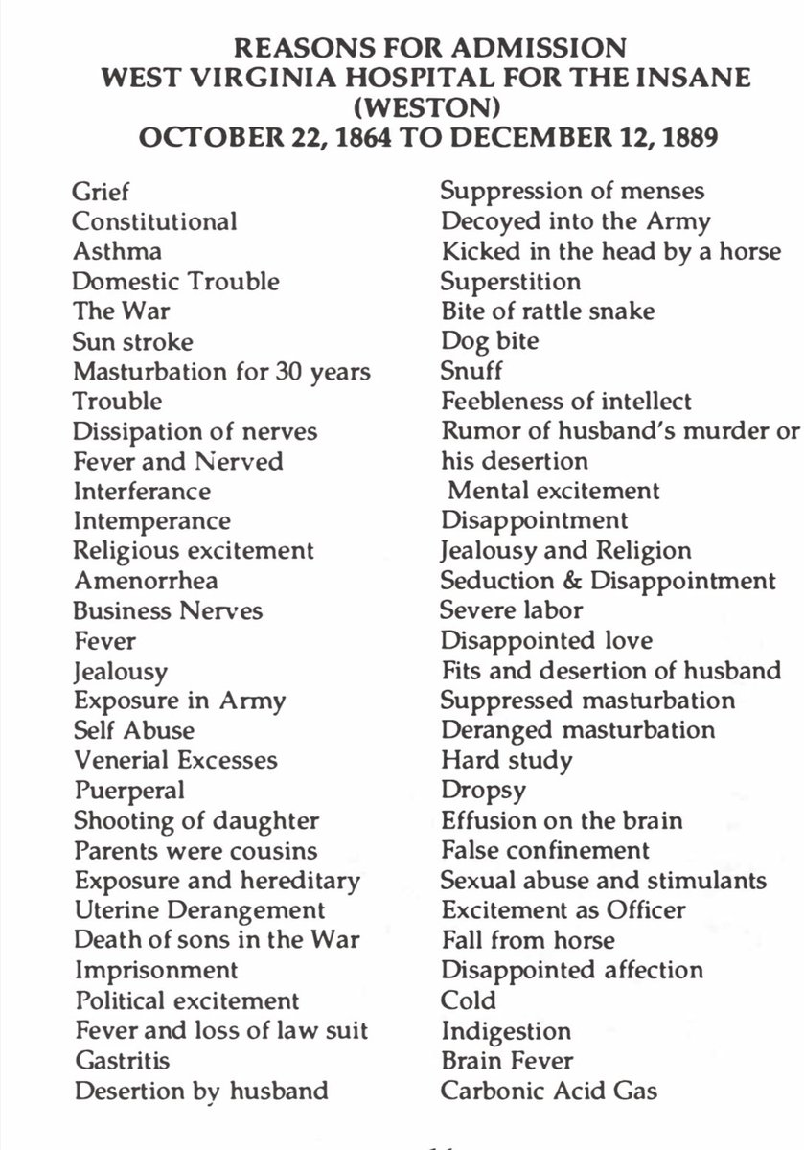
The Ghost of Mental Health Past
17th Century and Before:
Exorcisms
Trephining (drilling a hole into the head to release spirits)
18th Century:
Asylums
Often cruel/ inhumane
Used extreme treatments like electroconvulsive therapy and long submersions in cold water
Deinstitutionalized between 1950s and 1990s

Slide 5
The Ghost of Mental Health Present
Now, treatments for mental health rely on combinations of medications and therapy
While we treat people more humanely than in the past, we have yet to figure out a perfect system.
Mental health care requires health insurance or private pay
10% of Americans are in medical debt (that totals to hundreds of billions of dollars)
In correction facilities, the proportion of individuals with mental illness is 2 to 4 times the general population
Roughly 2/3 of currently unhoused individuals have a mental health disorder (note: study included US, Canada, and Germany)

Slide 6
Receiving Treatment in the Present
Involuntary treatment – therapy that is not the individuals choice.
E.g. weekly counseling sessions might be a condition of parole.
Voluntary treatment – the person chooses to attend therapy to obtain relief from symptoms.
Sources of psychological treatment include…
community mental health centers, private or community practitioners, school counselors, school psychologists or school social workers, group therapy.

Slide 7
Types of Therapy

Slide 8
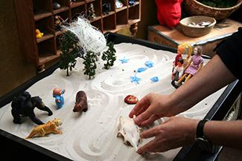
Play Therapy
A form of therapy used with children to help prevent/ resolve emotional conflicts, using toys as a medium
Nondirective play therapy – children are encouraged to work through problems by playing freely while therapist observes.
Directive play therapy – therapist provides structure/guidance by suggesting topics, asking questions, and playing with the child.

Slide 9
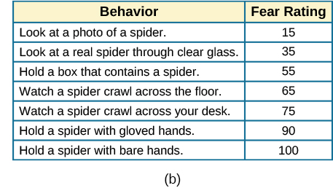
Behavior Therapy
Principles of learning are applied to change undesirable behaviors.
Aversive conditioning – uses an unpleasant stimulus to stop an undesirable behavior.
Antabuse (a medication that causes vomiting when combined with alcohol) to stop a person from drinking
Exposure therapy – client is repeatedly exposed to the source of their anxiety, in gradual steps, in a process known as systematic desensitization
Can also reward good behavior, using tokens or privileges

Slide 10
Cognitive Therapy
Based on the idea that how you think determines how you feel and act
To feel better, we want to reframe positives, and avoid cognitive distortions
Cognitive distortions include:
Overgeneralizing
Polarized (black & white) thinking
Jumping to conclusions

Slide 11
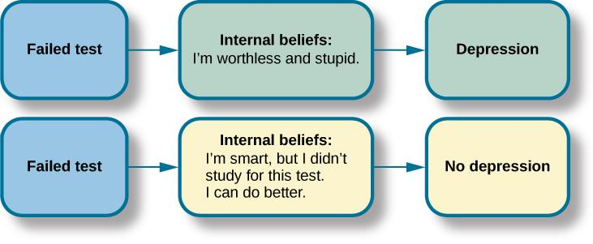
Cognitive Therapy Example
Which do you believe will lead to better mental health?

Slide 12
Cognitive-Behavioral Therapy
Cognitive-behavioral therapy (CBT) – works to change cognitive distortions and self-defeating behaviors.
Aims to change both how people think and how they act
Uses the ABC model to reveal cognitive distortions:
Action – activating event.
Belief about the event.
Consequences of the belief.

Slide 13
Humanistic Therapy
The goal is to increases self-awareness and acceptance through focus on conscious thoughts.
Techniques include:
Active listening
Unconditional positive regard
Genuineness, empathy, and acceptance towards clients

Slide 14
Biomedical Therapies
Psychotropic medications – medications used to treat psychological disorders
Treat the symptoms of psychological disorders but do not cure the disorder.
Antipsychotics – treat “positive” psychotic symptoms such as hallucinations, delusions, and paranoia by blocking dopamine
Atypical antipsychotics – treat the “negative” symptoms of schizophrenia such as withdrawal and apathy, by targeting both dopamine and serotonin receptors
Anti-depressants – alter levels of serotonin and norepinephrine.
Anti-anxiety agents – depress central nervous system activation
Mood stabilizers – treat episodes of mania as well as depression
Stimulants – improve ability to focus on a task and maintain attention Electroconvulsive therapy – induces seizures to help alleviate severe depression
Transcranial magnetic stimulation – magnetic fields stimulate nerve cells to improve depression symptom

Slide 15
Treatment Modalities

Slide 16
The (Typical) Process of Starting Therapy
Step 1: Seek treatment
Step 2: Intake appointment
Gather client information/ insurance, explain the process, and disclose concerns
Step 3: Create a treatment plan
How often do you need to meet?
Is it better to seek treatment individually or with other people?
What are specific goals for the treatment?

Slide 17
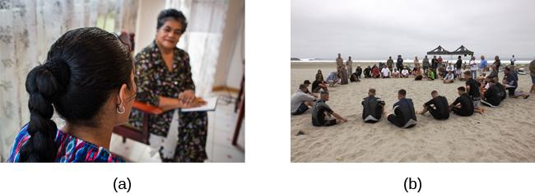
Types of Therapy
Individual therapy
Group therapy
Family therapy
Couples therapy

Slide 18
Substance Use Therapy

Slide 19
Substance Use and Addiction
What may begin as recreational use of a substance can develop into an addiction
Addiction – when a person has become physically or psychologically reliant on a substance
Physical dependence – changes in bodily functions that can cause withdrawal symptoms upon cessation of use
Psychological dependence – user is emotionally reliant on drug, and stopping may cause severe psychological distress
Withdrawal – experiencing a variety of symptoms (ranging from agitation to possible death) when a person stops using a drug
Tolerance – when a person needs more of a drug to receive the desired effect due to extended use
Detoxification – the process of slowly reducing substance use, to prevent severe withdrawal symptoms

Slide 20
Substance Use Therapy
Goal is to help an addicted person stop compulsive drug-seeking behaviors and reduce the chance of relapse
About 40%-60% of individuals relapse
May require treating comorbid mental health conditions
Therapy is most effective when its at least 3 months long
Can include a combination of individual, group, and family therapy

Slide 21
The Sociocultural Model
How do your cultural and religious beliefs affect your attitude toward mental health treatment?
Cultural competence – mental health professionals must understand and address issues of race, culture, and ethnicity and use strategies to effectively address needs of various populations.
Multicultural counseling and therapy:
Integrates the impact of cultural and social norms.
Aims to work with clients and define goals consistent with their life experiences and cultural values.
Strives to recognize client identities to include individual, group, and universal dimensions.
Advocates the use of universal and culture-specific strategies and roles in the healing process.
Balances the importance of individualism and collectivism in the assessment, diagnosis, and treatment of clients.

Slide 22
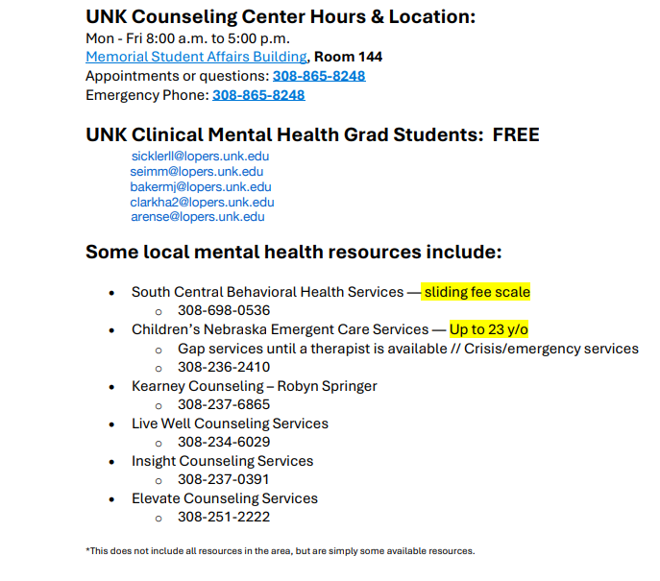
Mental Health Resources

Slide 23
Specific Resources
To Write Love on Her Arms
https://twloha.com/find-help/help-by-topic/self-injury/
Substance Abuse and Mental Health Services Administration
https://www.samhsa.gov/
Student Reporting Labs (provides lists on resources and info)
https://studentreportinglabs.org/mentalhealthresources/
Alcoholics Anonymous (AA) and Narcotics Anonymous (NA) meetings in Kearney
https://betteraddictioncare.com/meetings/nebraska/kearney/

Slide 24
Next time on PSY 203…
BEFORE NEXT CLASS:
NEXT CLASS:
Complete Ch 15 homework assignment
Due next Tuesday
Email Dr. S ASAP if you have questions
Watch for announcements
Bubble Day

